Slide 1
JavaScript
Intro
by Sofiia Matsyhin

Slide 2
WHAT IS JAVASCRIPT?
JavaScript (JS) is a dynamic computer programming language. It is most commonly used as part of web browsers, whose implementations allow client-side scripts to interact with the user, control the browser, communicate asynchronously, and alter the document content that is displayed.
Javascript also being used in server-side programming, game development and the creation of desktop and mobile applications.

Slide 3
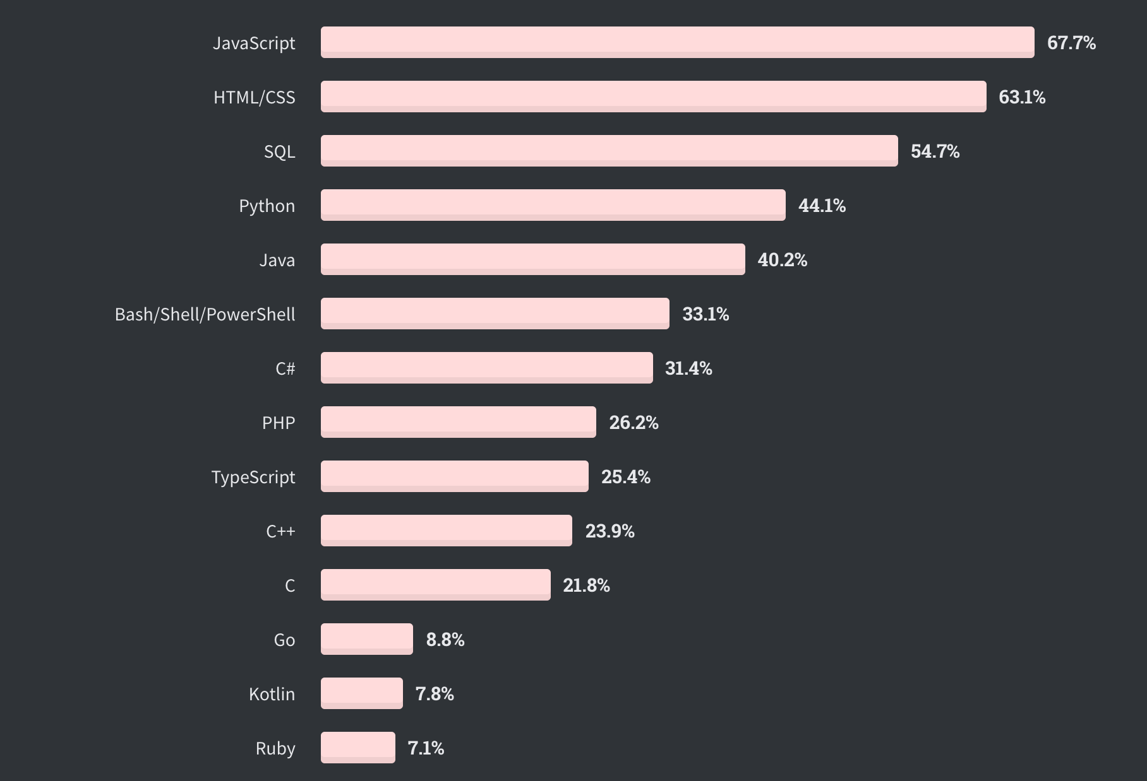
The most popular language!
Stack Overflow
Developer
Survey 2020

Slide 4
History of JavaScript

Slide 5
JavaScript was created by Brendan Eich in 1995 during his time at Netscape Communications. It was inspired by Java, Scheme and Self. Eich wrote one in 10 days.

Slide 6
First release of JavaScript
It was developed under the name Mocha, the language was officially called LiveScript when it first shipped in beta releases of Netscape Navigator 2.0 in September 1995, but it was renamed JavaScript when it was deployed in the Netscape Navigator 2.0 beta 3 in December.

Slide 7
What is EcmaScript?
ECMAScript (or ES) is a general-purpose programming language, standardized by Ecma International according to the document ECMA-262. It is a JavaScript standard meant to ensure the interoperability of Web pages across different Web browsers. ECMAScript is commonly used for client-side scripting on the World Wide Web, and it is increasingly being used for writing server applications and services using Node.js.

Slide 8
JavaScript engine
A JavaScript engine is a computer program that executes JavaScript (JS) code. The first JavaScript engines were mere interpreters, but all relevant modern engines utilize just-in-time compilation for improved performance. JavaScript engines are typically developed by web browser vendors, and every major browser has one. In a browser, the JavaScript engine runs in concert with the rendering engine via the Document Object Model. The use of JavaScript engines is not limited to browsers. For example, the Chrome V8 engine is a core component of the popular Node.js and Deno runtime systems. Since ECMAScript (ES) is the standardized specification of JavaScript, ECMAScript engine is another name for these engines.

Slide 9
JavaScript engine
V8 from Google is the most used JavaScript engine. Google Chrome and the many other Chromium-based browsers use it, as do applications built with CEF, Electron, or any other framework that embeds Chromium. Other uses include the Node.js and Deno runtime systems.
SpiderMonkey is developed by Mozilla for use in Firefox and its forks. The GNOME Shell uses it for extension support.
JavaScriptCore is Apple's engine for its Safari browser. Other WebKit-based browsers also use it. KJS from KDE was the starting point for its development.
Chakra is the JavaScript engine of the Internet Explorer browser. It was also forked by Microsoft for the original Edge browser, but Edge was later rebuilt as a Chromium-based browser and thus now uses V8.
Hermes is developed by Facebook for Android apps using the React Native framework.

Slide 10
How V8 works

Slide 11
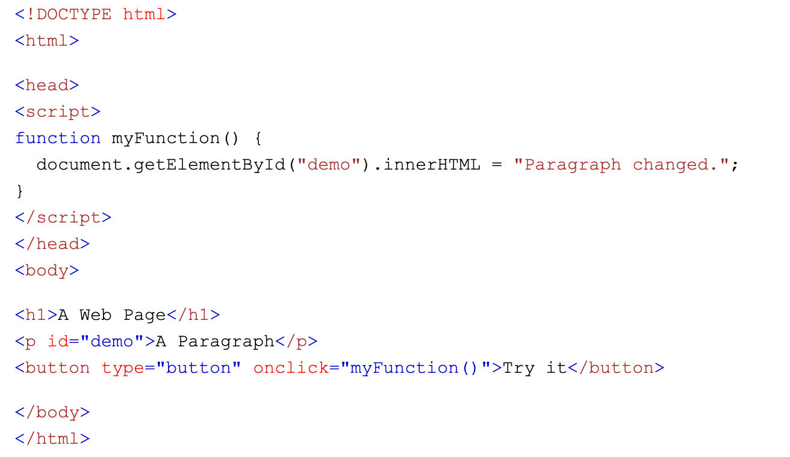
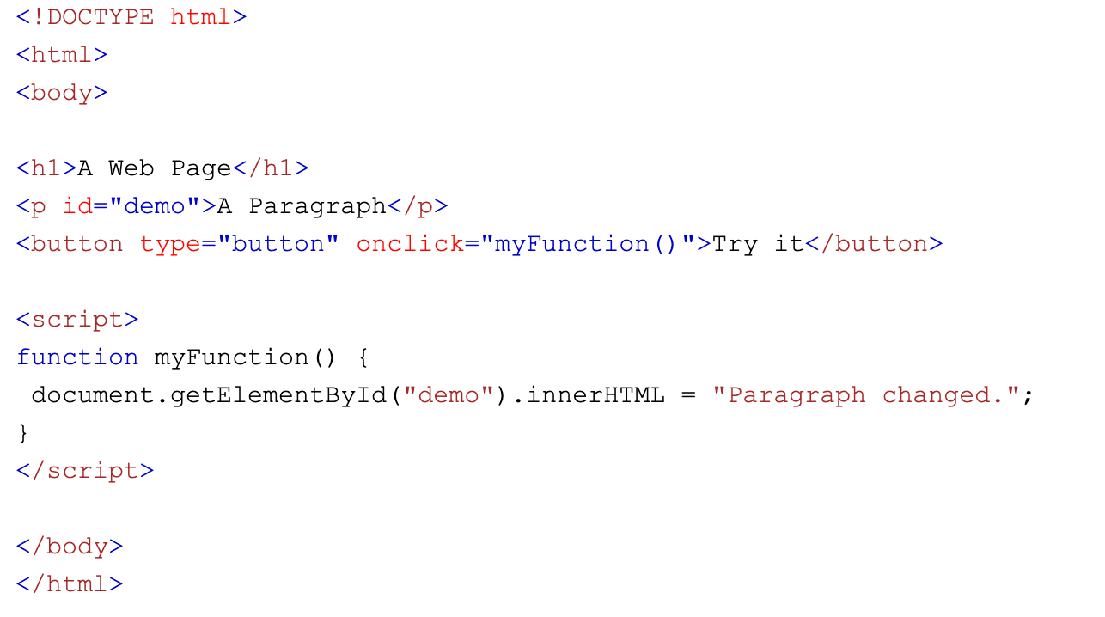
JavaScript Where To
JavaScript in <head> or <body>
You can place any number of scripts in an HTML document.
Scripts can be placed in the <body>, or in the <head> section of an HTML page, or in both.
Placing scripts at the bottom of the <body> element improves the display speed, because script interpretation slows down the display.

Slide 12


